Slide 1
Geocoding API Based On Address Parsing
Mustafa Arslan
Advisor: Assoc. Prof. Dr. Sezer Gören Uğurdağ
Yeditepe University
Faculty of Engineering and Architecture
Department of Computer Engineering
2015

Slide 2
Content
Introduction
Background
Design
Implementation
Evaluation
C0nclusion

Slide 3
Problem Statement
Geocoding systems are not accurate enough. They are finding a location in street or avenue level.
GeocoderAPI tries to find the exact location of the given postal address.
There are four problem in Geocoding a postal address.
Reorganization of settlements.
Postal address defects.
Incomplete addresses.
Special characters and notes in postal address

Slide 4
Introduction
What is postal address?
What is geolocation?
What is geocoding?
Limitations

Slide 5
Background
Postal Address Parts
Postal Address Structure
Problems Of Postal Address Geocoding
Geocoding Services

Slide 6
Background
Technologies
Database
Programming Language
Framework
Integrated Development Enviroment
Object Relational Mapping
LINQ (Language Integrated Query)
Web / Background Services

Slide 7
Design
Top-down Approuch
Categorization of Address Levels
City
Town
POI ( Places of interest)
Quarter
Avenue
Street
Door

Slide 8
Design
Geocoding systems work like a navigation system.
GeocoderAPI consists of 3 modules;
Fixer
Tokenizer
Geocoder

Slide 9
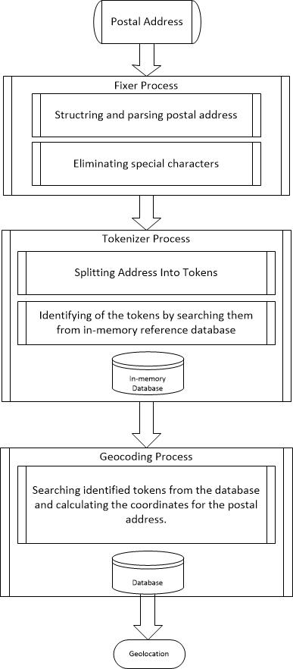
General Flow
Of Geocoder

Slide 10
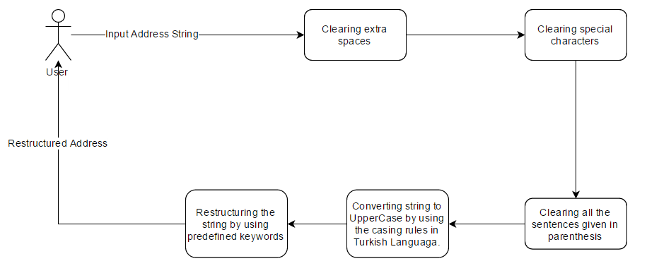
Flow of Fixer

Slide 11
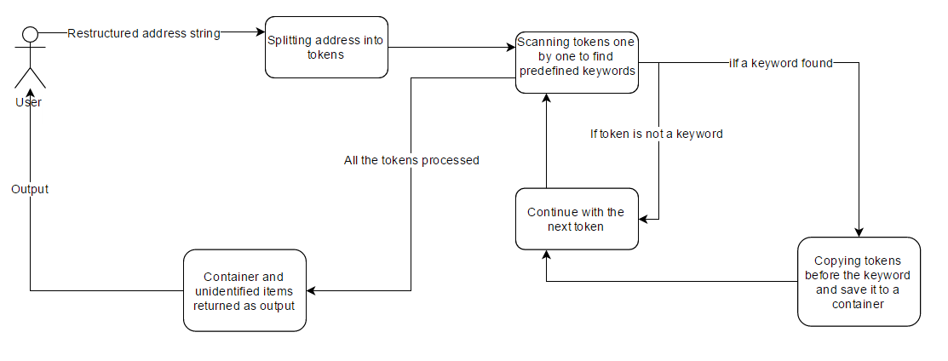
Flow Of Tokenizer

Slide 12
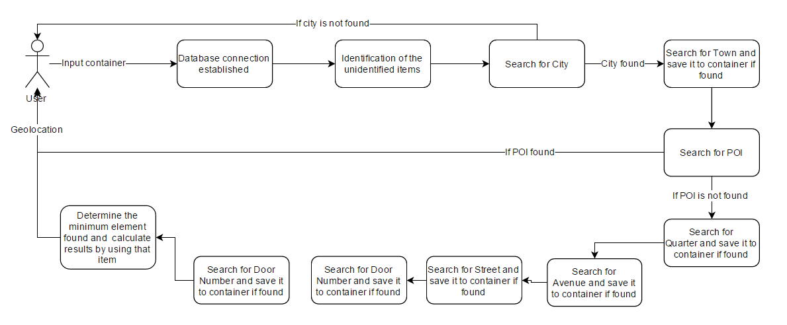
Flow Of Geocoder

Slide 13
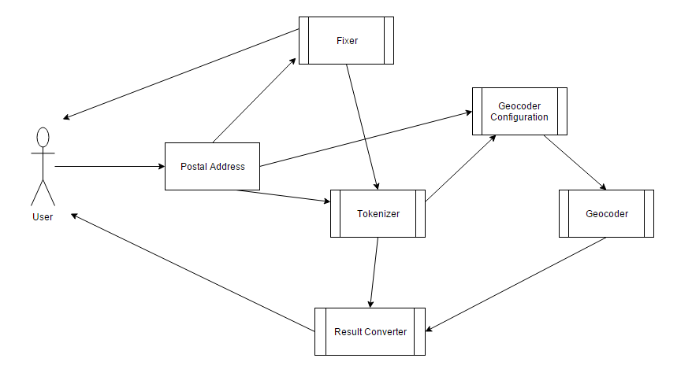
Use Case Diagram

Slide 14
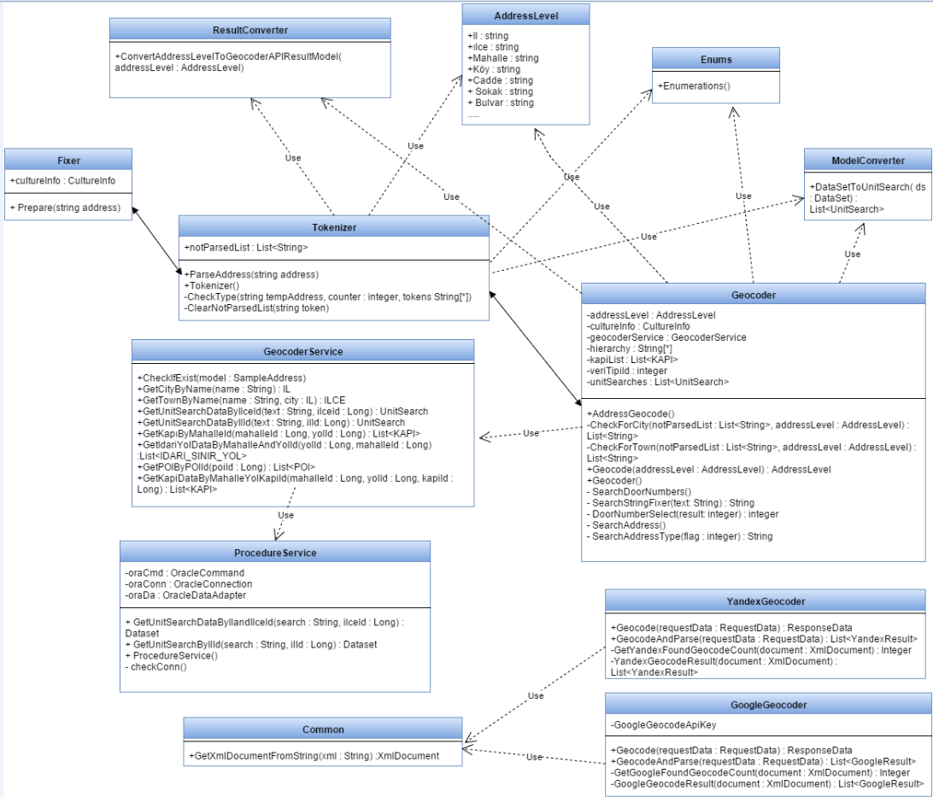
Class Diagram

Slide 15
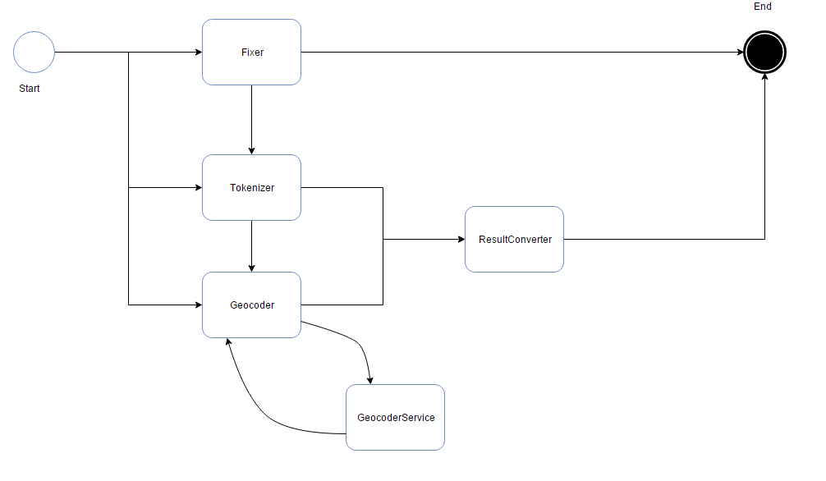
State Diagram

Slide 16
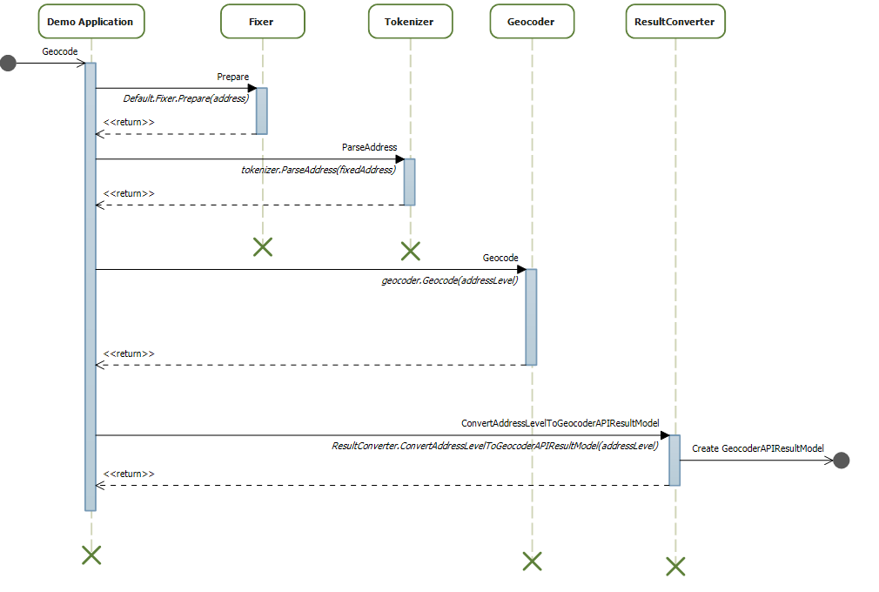
Sequence Diagram

Slide 17
Implementation
This part is splitted to four parts.
Fixer
Tokenizer
Geocoder
Database

Slide 18
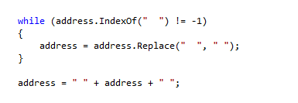
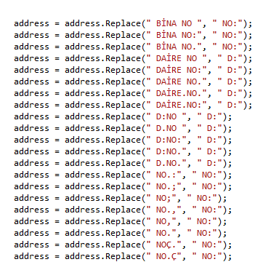

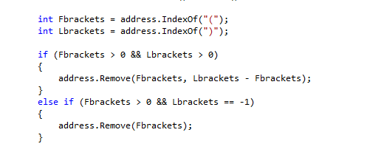
Fixer
1-Fixer clears all extra spaces
3-Fixer replaces address parts
with predefined keywords
2-Fixer converts address to upper case
4-Fixer converts address to upper case

Slide 19
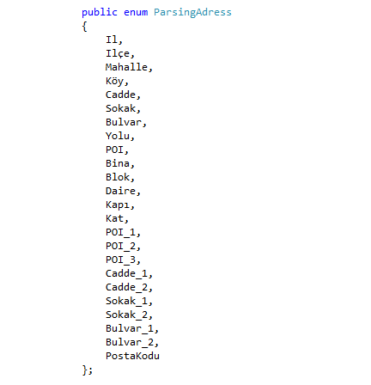
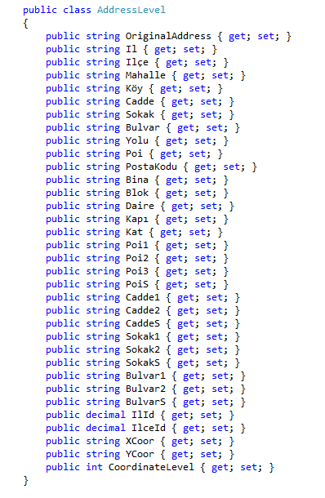

Tokenizer
Keywords of Tokenizer
Output Of Tokenizer
Tokenizer splits address into tokens
9

Slide 20
Geocoder
Geocoder is the main process of this system.
Geocoder can be used individually.
It starts with the top most element and goes for the smallest element.
Geocoder searches the unidentified items first.
City is the only mandatory item.

Slide 21
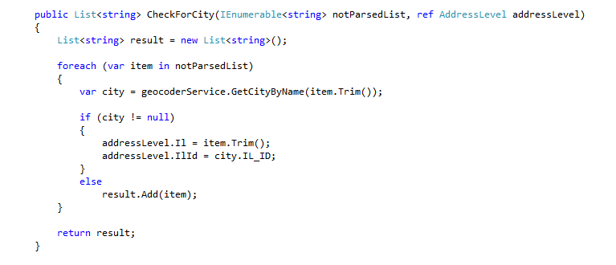
Geocoder
Geocoder searches unidentified item to find the city.

Slide 22
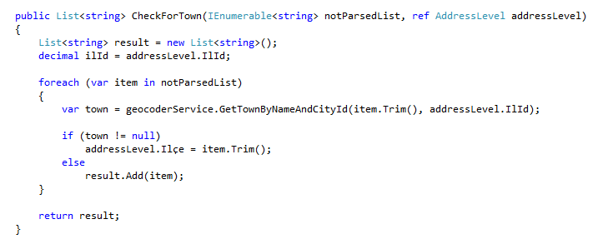
Geocoder
Geocoder searches unidentified item to find the town.

Slide 23
Geocoder
Geocoder tries to find POI after that because database has exact locations for POI’s.
Other items are individually useless. An oracle procedure is created to connect these items.
Procedure create relationship between town, quarter, avenue and street.
It stores this relationship into an oracle view.
This procedure is also help geocoder to detect incomplete addresses.
Geocoder tries to detect door if it is given in order to find the exact location.

Slide 24
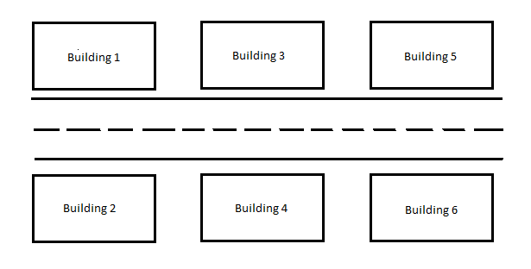
Geocoder
Geocoder tries to find the exact location, because of that, It tries to find the door number.
Sample database doesn’t have all the door numbers in Turkey
Door search system is developed in order to find the closest door number.
Door numbering in Turkey

Slide 25
Database
Oracle 11g Express edition is used in this project.
Sample database is given by Infotect.
GeocoderAPI is database free.
It has 9 tables and 1 view.

Slide 26
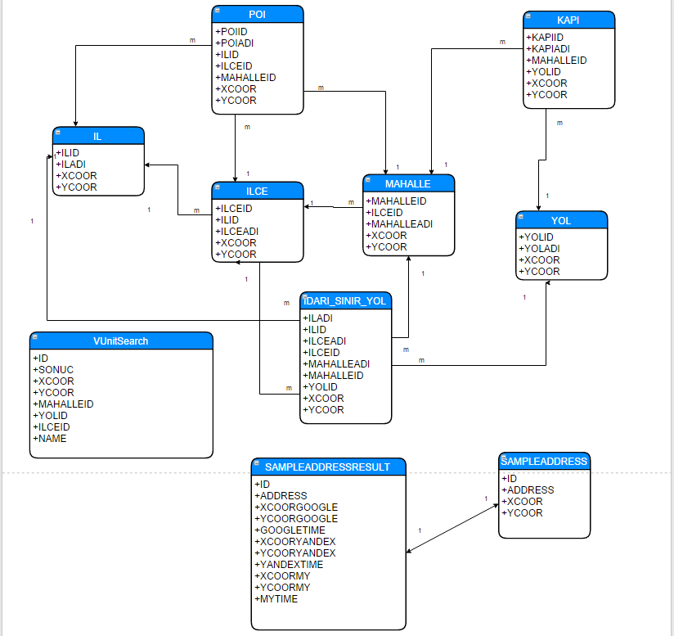
Database

Slide 27
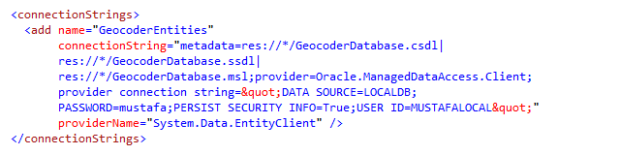
Database
Entity Framework is used to access to database.
Necessary informations are stored in configuration file.
Configuration file holds the provider name, connection string and database type.

Slide 28
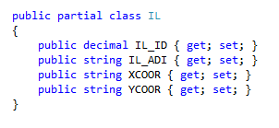
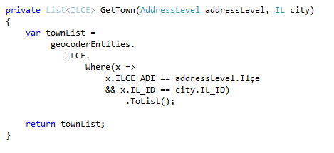
Service Layer
Between database and application level, service layer is implemented.
This layer holds every query.
Entity Framework is used here to access to database. It creates application level objects by using database objects.
LINQ is used for making queries.

Slide 29
Evaluation
This project is tested with sample address database. It is given by Aras Kargo.
Sample address database has 2554 different addresses with exact location.
Google and Yandex geocoding services are used to calculate the success rate of this project.
Test cases of this project are;
1) Geolocation detection rate
2) Correct Geolocation detection rate
3) Geolocation search time performance

Slide 30
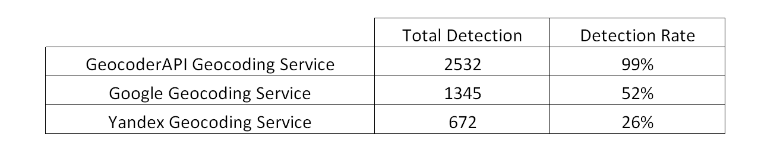
Evaluation (Geolocation detection rate)

Slide 31
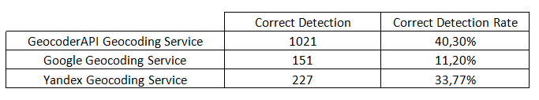
Evaluation (Correct Geolocation detection rate)

Slide 32
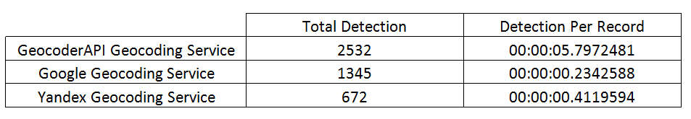
Evaluation (Search Time Performance)

Slide 33
Conclusion
GeocoderAPI tests show an acceptable results in geocoding postal addresses.
Its geolocation search success can be improved by giving new keywords.
Geolocation search success can be improved by using self-learning algorithms.
Fuzzy match algorithms can be used to improve geocoding success.
In terms of search speed, GeocoderAPI is not efficient enough. By using NoSQL databases or search optimizers, it can be improved.
This project can be used in route optimization, navigation, delivery optimization and location based researches.

Slide 34


Slide 35


